Slide 1







PROJECTS | PRODUCTS | COURSE | INTERNSHIP
info@discoverprojects.com
www.discoverprojects.com
pro.aiskool@gmail.com
www.aiskool.com
Shop no. 2, Narayan Smurti Building, Opp. Saraswati Book Depot,
Near CIDCO Bus Stop, Thane West, India.
+91 9967478289 / +91 9167769993

Slide 2


MEDICAL COSTS WITH RESPECT TO BMI
Relevant Image

Slide 3
Introduction and Application
The objective is build a machine to predict the medical costs with respect to BMI with the help of decision trees (regression method).

Slide 4
Working
FIRST STEP WAS TO COLLECT DATA FROM DIFFERENT SOURCES FOR OUR PROBLEM STATEMENT .
THEN WE HAVE TO CLEAN , PROCESS CATEGORICAL DATA AND NORMALISE IT.
THEN WE SHOW VARIOUS ANALYSIS USING GRAPHS.
SPLIT THE DATA INTO TRAINING AND TEST SET.
SELECT AN ALGORITHM.
FITTING THE MODEL TO TRAINING SET.
SAVING THE MODEL
CHECK ACCURACY OF TRAINED DATA W.R.T TRAIN SET.
TEST THE TRAINED MODEL W.R.T TESTING SET.
CHECK ACCURACY OF TEST DATA W.R.T TEST SET.
BASED ON THE GENERATED GRAPHS WE PREDICT THE MEDICAL COSTS WITH RESPECT TO BMI.

Slide 5
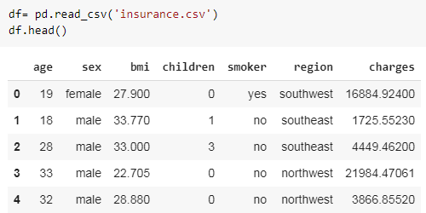
Working and Building
This is the data that we are using for the prediction of medical costs with the help of BMI. The source of dataset is Kaggle. We have used the read_csv() function of pandas to read the .csv file for dataset and head() function to display the first five lines of dataset.

Slide 6
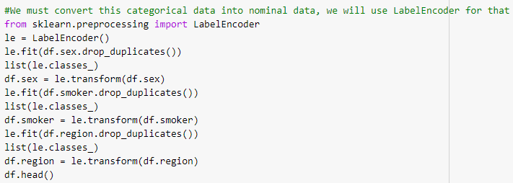
Handling Categorical Data
Label encoding is simply converting each value in a column to a number.

Slide 7

Normalise Data
StandardScaler transforms features by scaling each feature to a given range.
fit(self, X[, y]):
Compute the minimum and maximum to be used for later scaling.
transform(self, X):
Scale features of X according to feature_range.

Slide 8
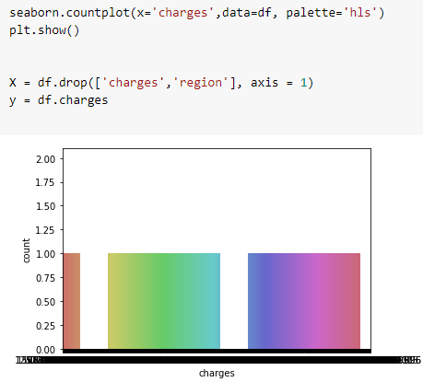
Graphs
countplot. Show the counts of observations in each categorical bin using bars. A count plot can be thought of as a histogram across a categorical.

Slide 9
Splitting Data
Python has a library sklearn which contains a function ‘train_test_split’. This function is used to Split arrays or matrices into random train and test subsets.
test_size float or int, default=None:
If float, should be between 0.0 and 1.0 and represent the proportion of the dataset to include in the test split. If int, represents the absolute number of test samples. If None, the value is set to the complement of the train size. If train_size is also None, it will be set to 0.25.
random_state int or RandomState instance, default=None
Controls the shuffling applied to the data before applying the split. Pass an int for reproducible output across multiple function calls.

Slide 10

Selecting Algorithm
The decision trees is used to fit a sine curve with addition noisy observation. As a result, it learns local linear regressions approximating the sine curve.

Slide 11

Fitting the model to trained dataset
We have used the fit() function to fit our model to the training dataset and hence passed the parameters for the same.

Slide 12
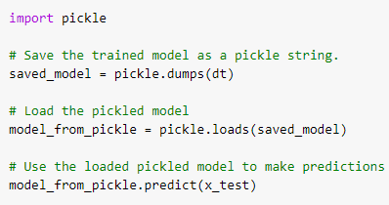
Saving the model
We can use the Pickle library in Python to save our model. In this code we can see that the model has been saved as a string.
So, first we save the model as a string, then we load it and use it to make predictions.

Slide 13
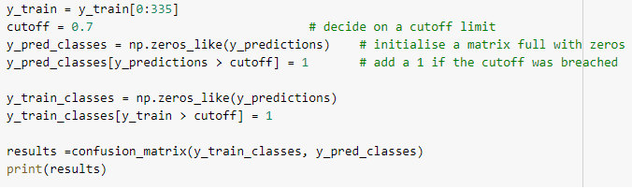
Confusion Matrix
Confusion Matrix function is present in the sklearn library of Python. A confusion matrix is a table that is often used to describe the performance of a classification model (or “classifier”) on a set of test data for which the true values are known. It allows the visualization of the performance of an algorithm.

Slide 14
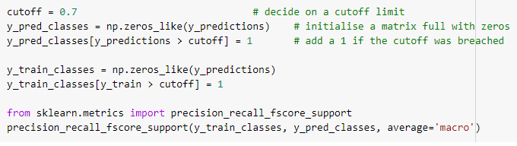
Precision, Recall, Support, Fscore
The precision is intuitively the ability of the classifier not to label as positive a sample that is negative. The recall is intuitively the ability of the classifier to find all the positive samples.The F-beta score can be interpreted as a weighted harmonic mean of the precision and recall, where an F-beta score reaches its best value at 1 and worst score at 0.The support is the number of occurrences of each class in y_true. We have used the precision_recall_fscore_support() function for the same.
**In the same way we will calculate the confusion matrix, precision, recall, support and fscore for the test dataset.**

Slide 15
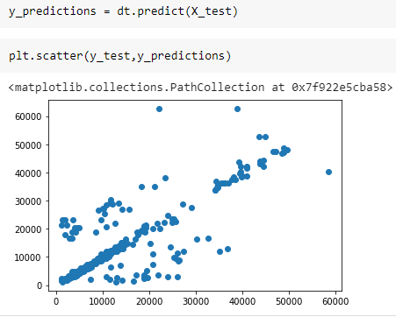
Prediction
We have used the predict() function for making the predictions on our model. Also, scatter() method is used to plot the graph for our predictions.

Slide 16
Evaluate, Tune and Improve Neural Network
In this code we have used the MSE, MAE and RMSE method for evaluation.
Mean Absolute Error: We know that an error basically is the absolute difference between the actual or true values and the values that are predicted.
Mean Square Error: MSE is calculated by taking the average of the square of the difference between the original and predicted values of the data.
Root Mean Square Error: RMSE is the standard deviation of the errors which occur when a prediction is made on a dataset. This is the same as MSE (Mean Squared Error) but the root of the value is considered while determining the accuracy of the model.

Slide 17

Calculating Efficiency:
Accuracy is the most intuitive performance measure and it is simply a ratio of correctly predicted observation to the total observations. One may think that, if we have high accuracy then our model is best. Yes, accuracy is a great measure but only when you have symmetric datasets where values of false positive and false negatives are almost same. Therefore, you have to look at other parameters to evaluate the performance of your model.
Accuracy = TP+TN/TP+FP+FN+TN

Slide 18
FAQ
1.What is Decision Tree?
Decision tree algorithm falls under the category of supervised learning. They can be used to solve both regression and classification problems.Decision tree uses the tree representation to solve the problem in which each leaf node corresponds to a class label and attributes are represented on the internal node of the tree.We can represent any boolean function on discrete attributes using the decision tree.
2.What are the benefits of Decision Trees?
Well-structured Delivery of Resolutions
Improved First Call Resolution (FCR)
Reduced Average Handling Time (AHT)
Improved Customer Satisfaction (CSAT) Rate
Improved Customer Experience

